Slide 1





Applied Machine Learning (CS-4104) Project Presentation
Ayaan Danish (20K-0245 | BCS-7A)

Slide 2
Problem Statement
There are many unique human traits that have been used for biometric purposes.
Face, iris, fingerprint, voice, and gait are examples.
This paper proposes the use of veins on the palmar and dorsal parts of the hands to uniquely identify subjects.
Palm-veins are a novel biometric.
Has inbuilt anti-spoofing qualities and high stability, making it impossible to fake. Additionally, veins cannot be read from lifeless bodies or severed hands.
And imagery is not occluded by makeup or accessories.
The major contribution of this paper is that it combined three CNN models using Decision-Level Fusion to obtain a robust and highly accurate ensemble CNN system that can accurately perform palm-vein recognition.

Slide 3
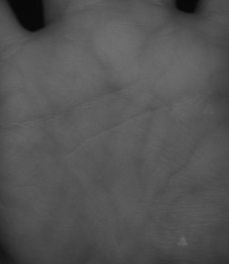
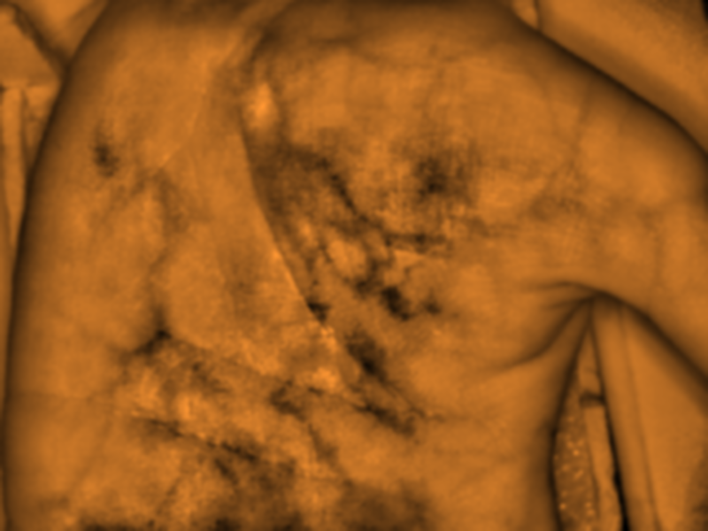
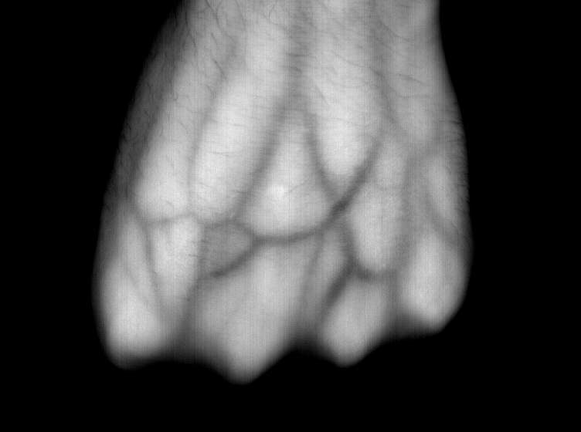
Datasets
Three different datasets were used to train and test the proposed architecture.
(i) VERA Palmvein Database, (ii) FYO Database, and (iii) DorsalVein Dataset were used.
The original paper used the PUT PalmVein Dataset, but due to lack of public availability the DorsalVein Dataset was used as a substitute in this study.
VERA consists of 2,200 images from 110 different subjects, from 2 sessions.
FYO Database contains palmar, dorsal, and wrist vein samples for 160 subjects. This paper used the palmar samples, of which there are 640.
DorsalVein Dataset consists of 1,104 images from 138 different subjects.
VERA Sample Image
FYODB Sample Image
DorsalVein Sample Image

Slide 4

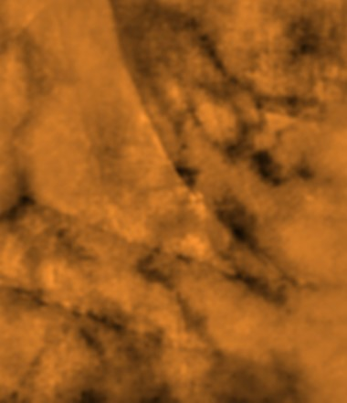
Data Preparation – ROI Extraction
The images were initially prepared by extracting their regions of interest (ROI).
Involves cropping out background and extra areas like fingers and wrist, to ensure focus on the veins only.
Carried out semi-automatically by the original paper, but in this study the ROI images were already available in the dataset files.
Original FYODB Image vs ROI Image

Slide 5
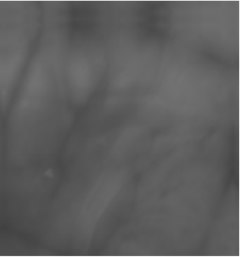
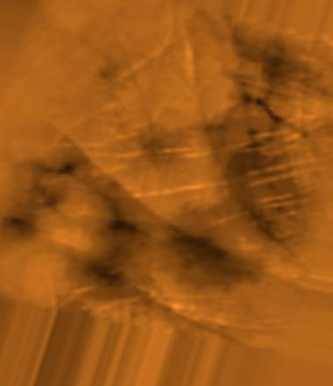
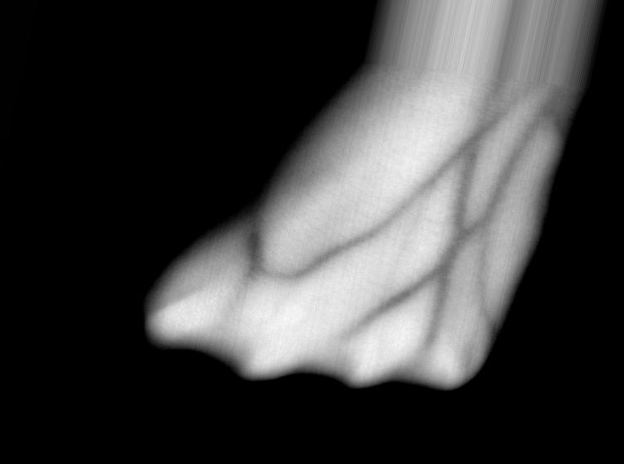
Data Preparation - Augmentation
Since the CNN models are trained from scratch without transfer learning, there is a need of high data volumes to ensure generalization.
For this purpose, each dataset was augmented using Keras Image Generator to increase the number of samples per class.
This greatly increased the number of samples for each dataset, for e.g, FYODB size was increased from 640 images to 6,400 and DorsalVein size was increased from 1,104 to 5,520
Augmentations applied include rotation, width shift, height shift, shearing, zooming, flipping, and brightness changing.
VERA Sample Augmented Image
FYODB Sample Augmented Image
DorsalVein Sample Image

Slide 6
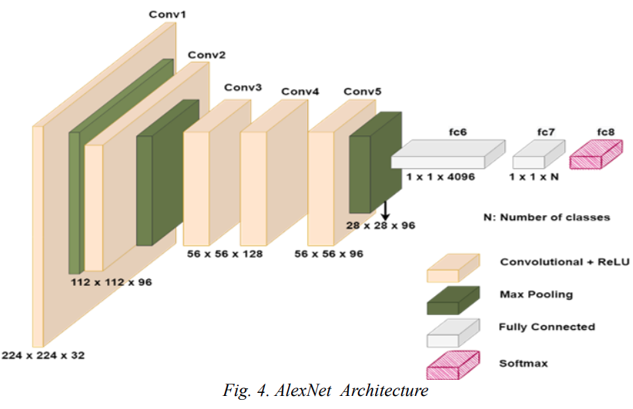
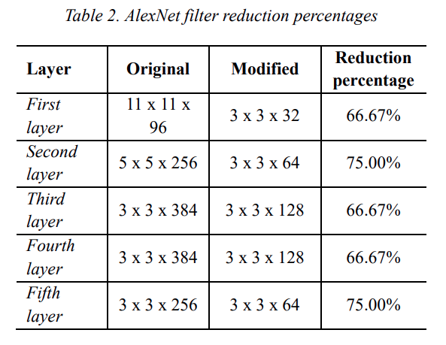
CNN Models - AlexNet
AlexNet is a simple yet extremely successful CNN architecture, originally trained on the ImageNet dataset.
It consists of 5 blocks with only one convolutional layer in each (11x11 filter to 3x3 filter), followed by ReLU activation, Batch Normalization, and Max Pooling with a 3x3 filter (see architecture below).
A major contribution of this paper was to reduce the number of filters and filter size per CONV layer for each CNN model, thus greatly reducing training time while upholding model efficiency and accuracy.
The reduction in filters made in the AlexNet architecture is shown below.

Slide 7
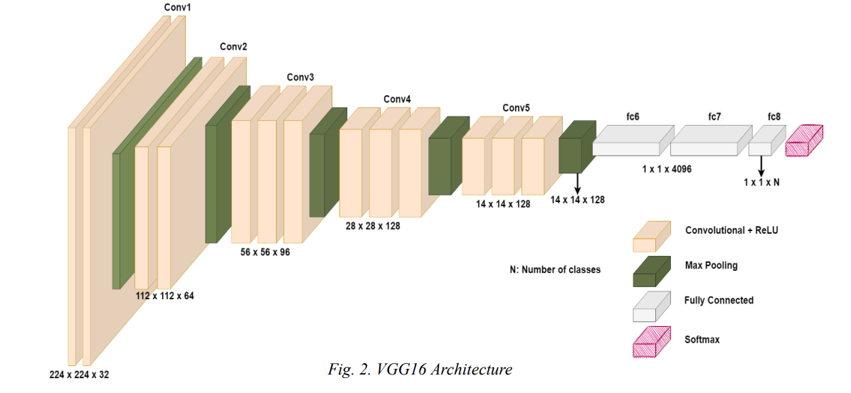
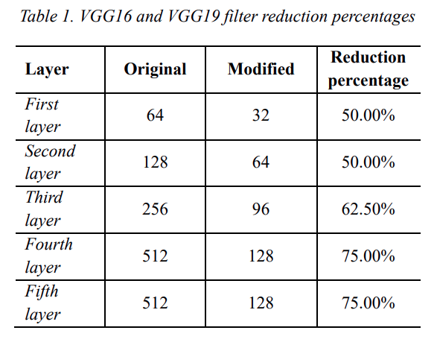
CNN Models –VGG16
VGGNet is a family of CNN models with slightly different architectures.
The 16 in VGG16 means that it has 16 CONV layers, spread out in 5 blocks.
All CONV layers use ReLU activation function and 3x3 filter size, followed by Batch Normalization and Max Pooling with a 3x3 filter and stride of 2.
The reduction in filters made in the VGG16 architecture is shown below.

Slide 8
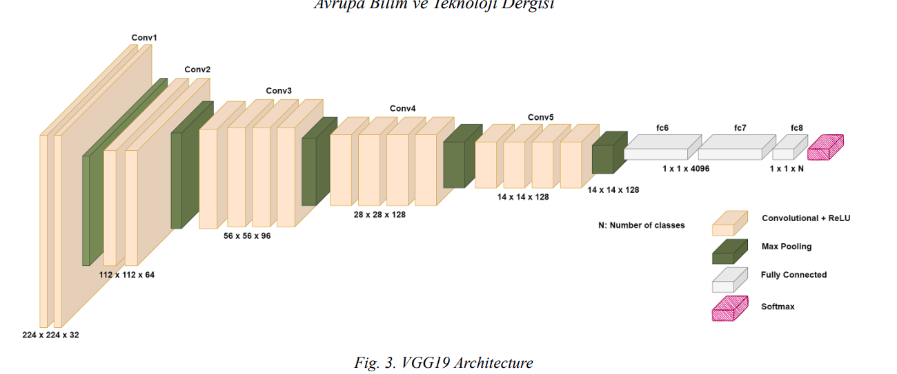
CNN Models –VGG19
VGG19 is another member of the VGGNet family of CNN models.
It consists of 19 CONV layers spread out in 5 blocks.
The architecture of VGG19 is identical to VGG16, but with the addition of an additional CONV layer in blocks 3, 4 and 5.
The reduction in filters made in the VGG19 architecture is shown below.

Slide 9
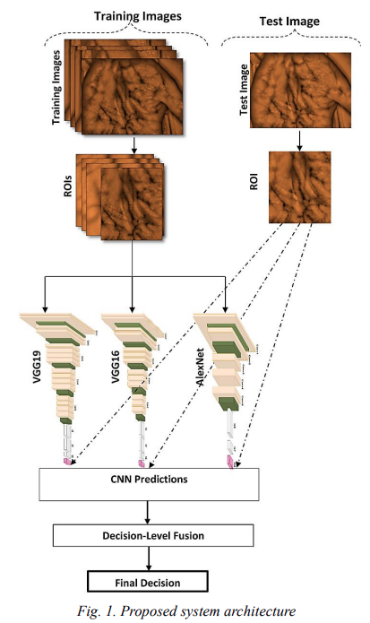
Architecture and Methodology
The proposed architecture involves training splitting the datasets into test and training partitions. An 80-20 train-test split was used.
In this study, a validation partition was also created to detect overfitting during training. An 80-20 train-validation split was used.
The 3 CNN models are trained on each dataset and their individual performance is evaluated on the testing dataset.
Finally, Decision-Level Fusion is used to fuse the inference power of the three models and obtain a more accurate classification of the palm-vein image.
Training epochs were fixed at 30 for all training sessions.
The reduction in filter size for all CNNs led to a reduction of up to 450% in computation time, leading to massively faster training.
Training was performed on an Nvidia GTX 1660 GPU, with 6GB VRAM.

Slide 10
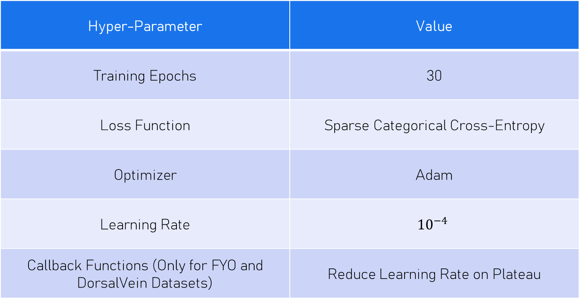
Hyper-Parameters
Hyper-Parameter | Value
Training Epochs | 30
Loss Function | Sparse Categorical Cross-Entropy
Optimizer | Adam
Learning Rate | $${10}^{−4}$$
Callback Functions (Only for FYO and DorsalVein Datasets) | Reduce Learning Rate on Plateau

Slide 11
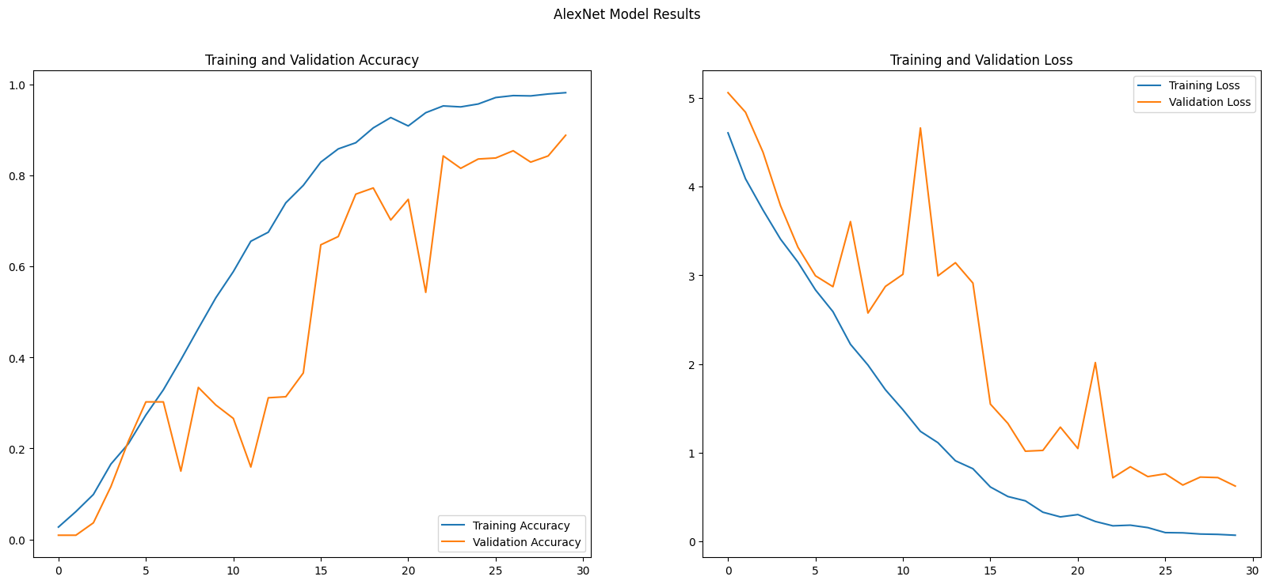
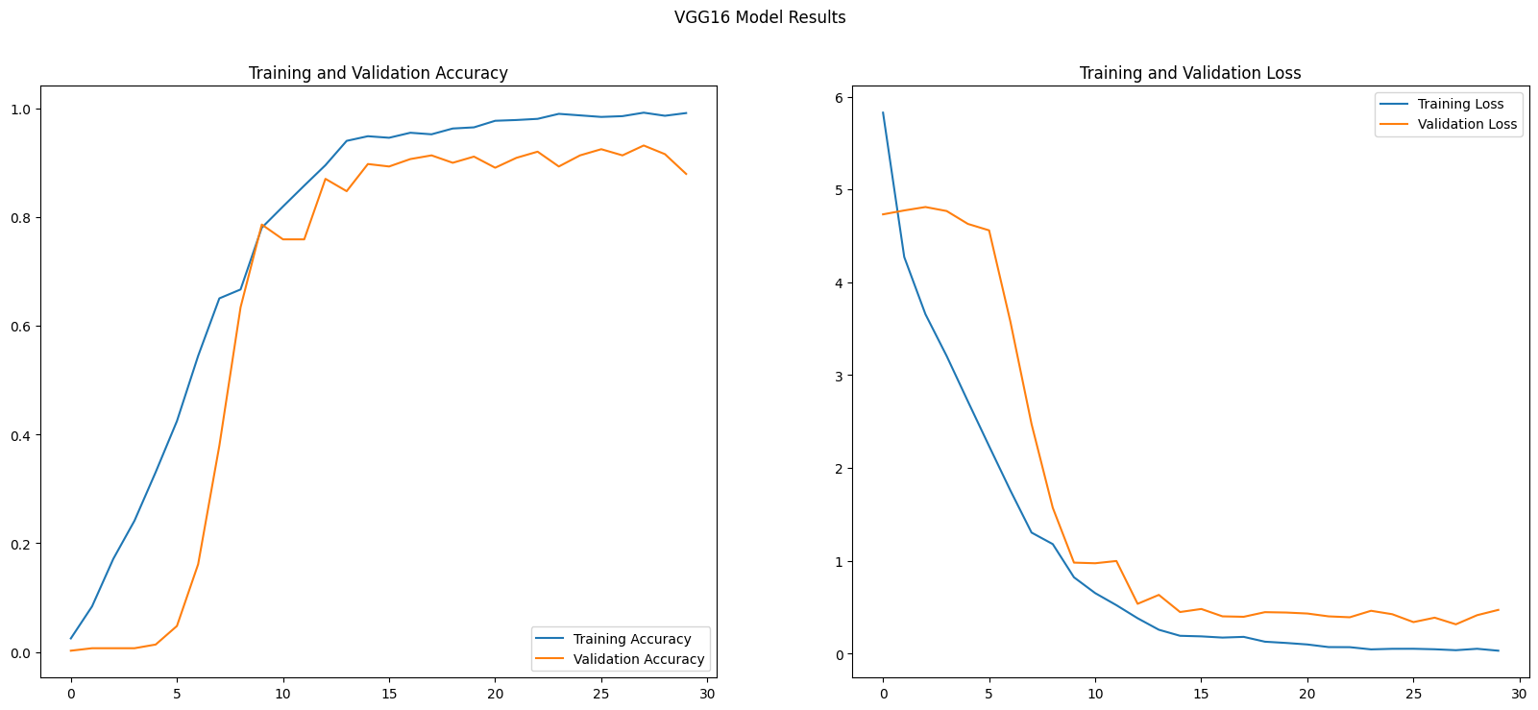
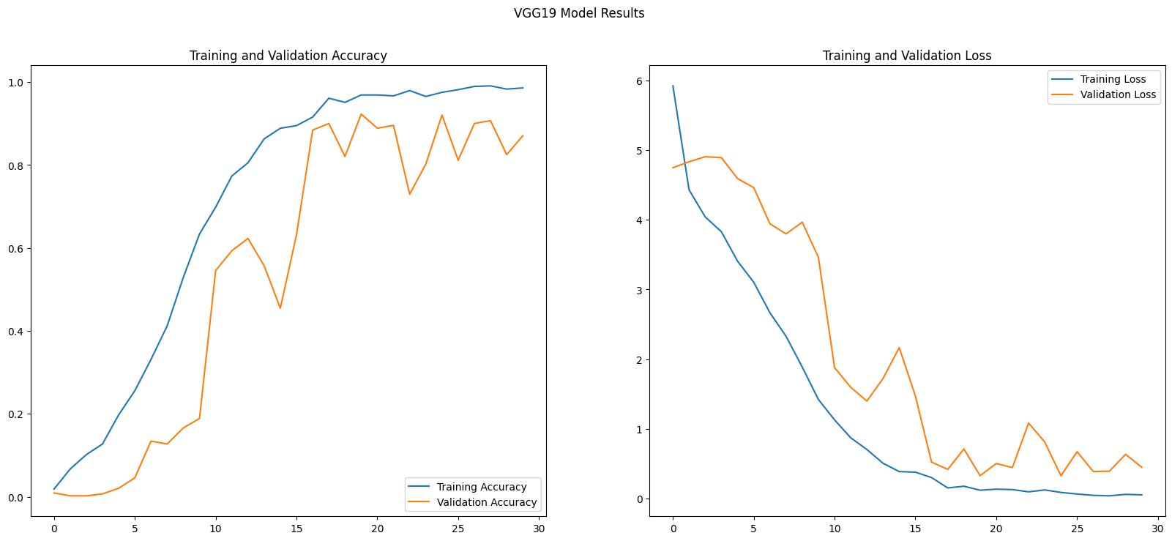
Results – VERA PalmVein
CNN Model | Test Accuracy | Computation Time
AlexNet | 98.86% | 92.03s
VGG16 | 94.89% | 775.11s
VGG19 | 97.44% | 419.39s

Slide 12
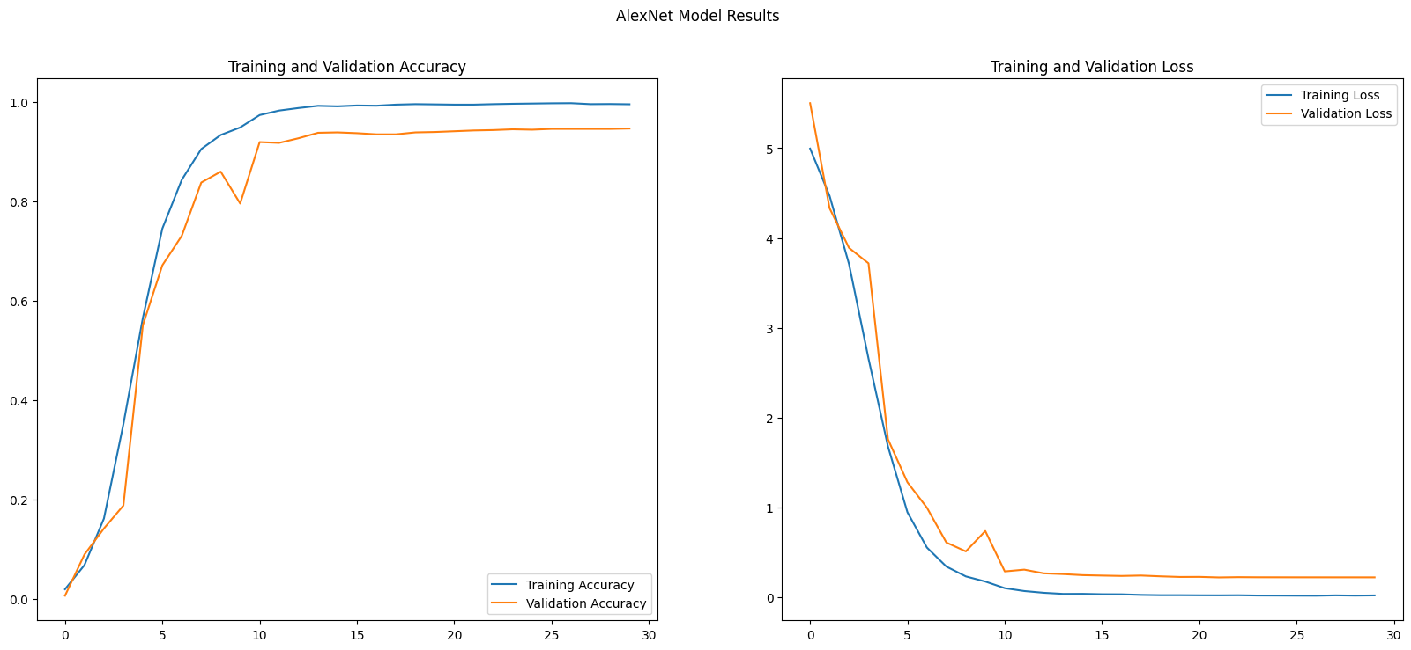
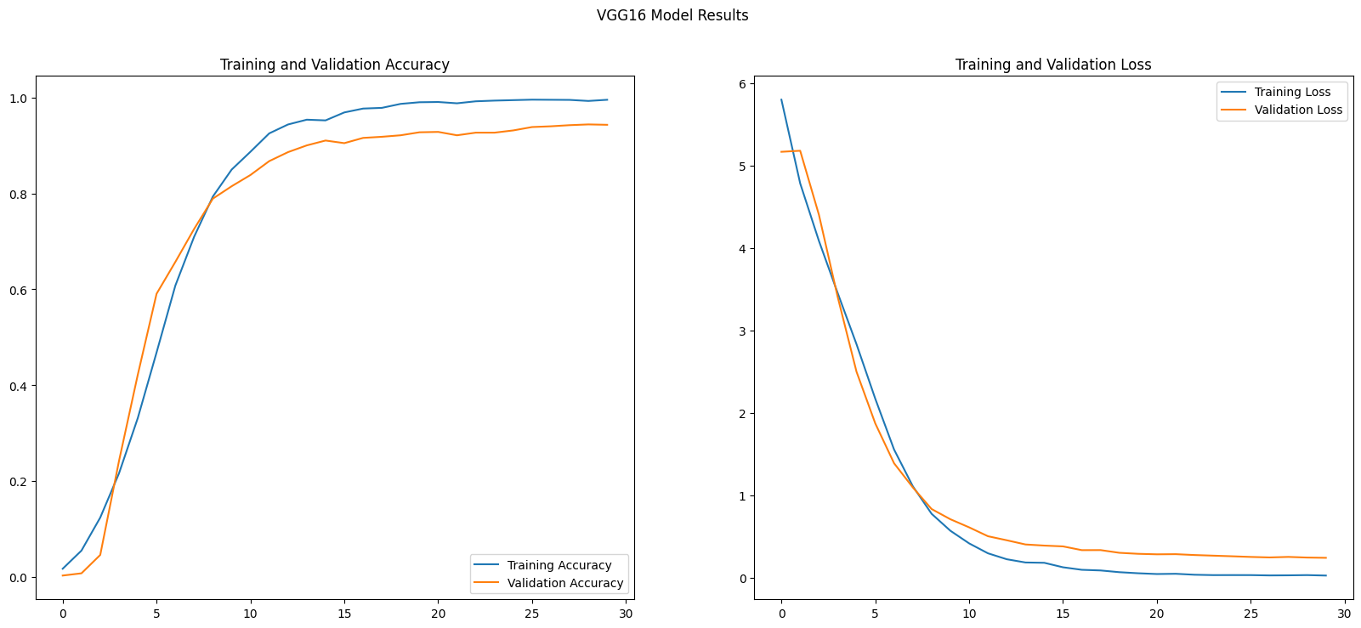
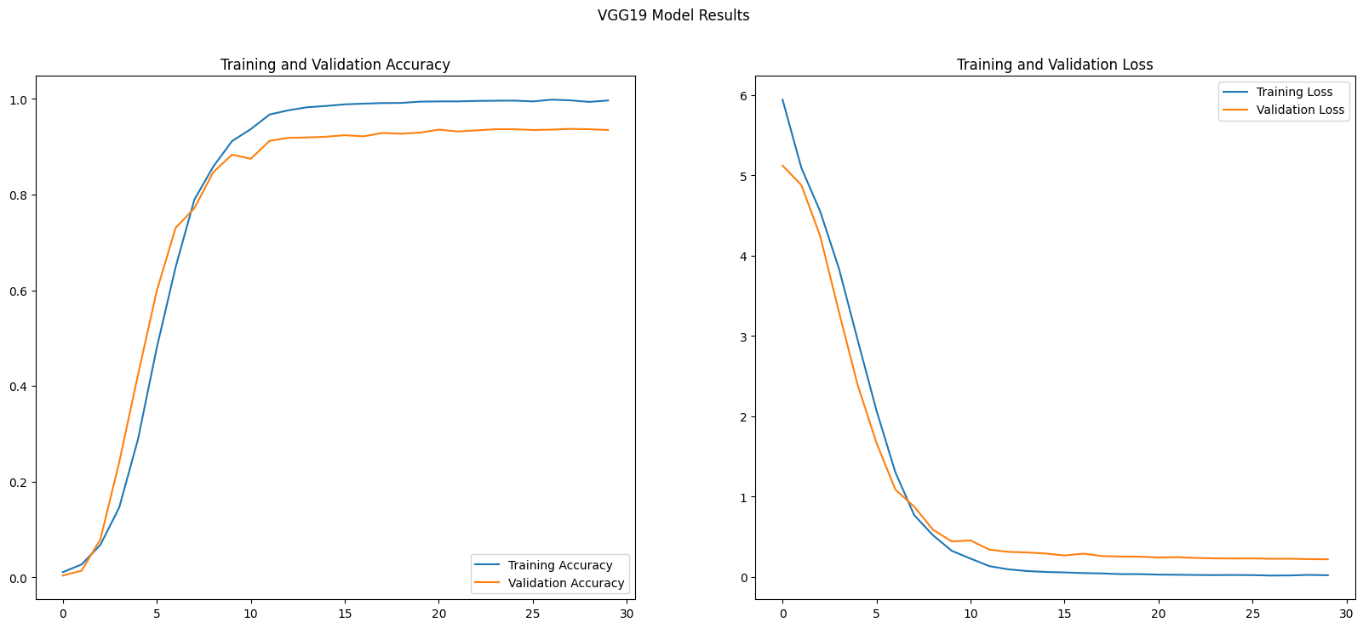
Results – FYO Database
CNN Model | Test Accuracy | Computation Time
AlexNet | 95.90% | 144.15s
VGG16 | 95.70% | 962.15s
VGG19 | 95.51% | 1047.67s

Slide 13
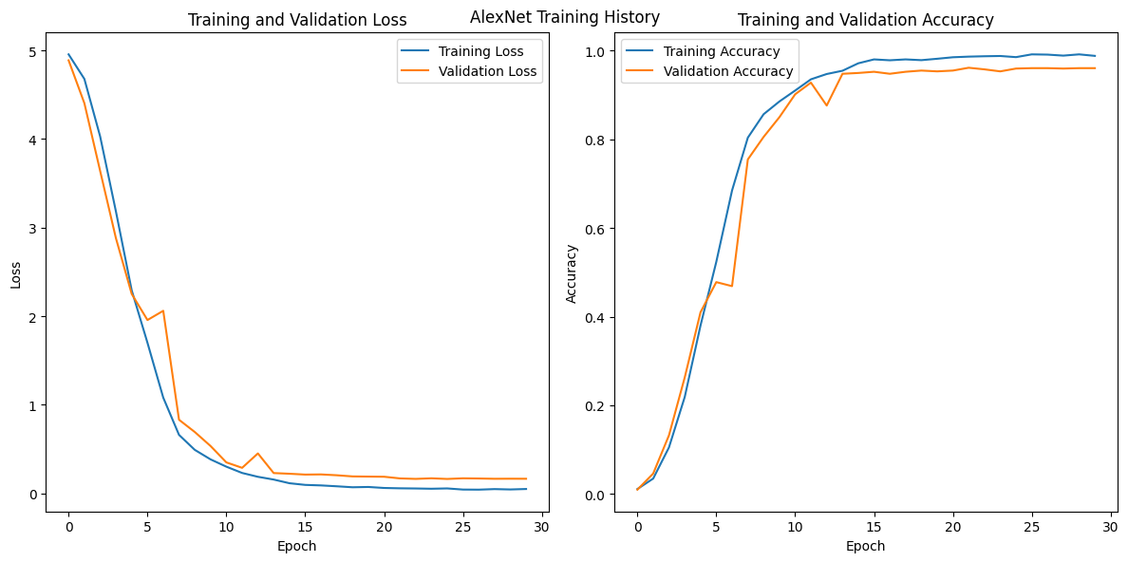
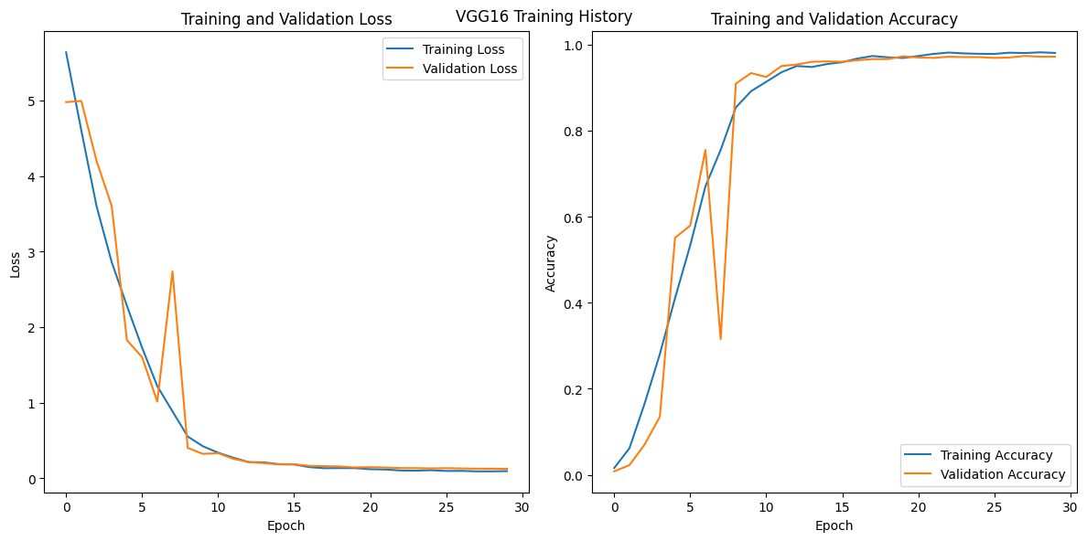
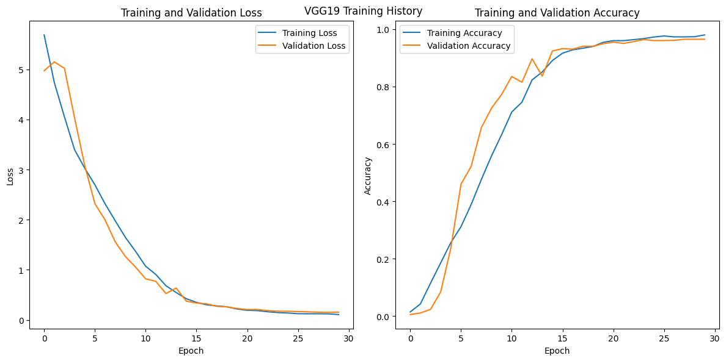
Results – DorsalVein Dataset
CNN Model | Test Accuracy | Computation Time
AlexNet | 97.56% | 134.37s
VGG16 | 99.84% | 808.03s
VGG19 | 97.91% | 865.49s

Slide 14
Decision-Level Fusion
Decision-Level Fusion was used after all models were trained to combine their inference power.
Creating an ensemble of models allows for more accurate predictions; each model overcomes the shortcomings of the other.
The fusion technique used in the paper involves gathering predictions from each model, assigning a weight of 1 to correct and 0 to incorrect prediction, and adding the weights.
A sum ≥ 2 indicates a correct prediction by the ensemble.
This study however proposes a slightly modified fusion method that yields better results with higher accuracy.
It involves creating a set of predictions from each model, and simply taking the mode of that set to yield the ensemble prediction. This decision is then compared with the label to judge correctness.
The improved fusion technique yields slightly higher accuracy.

Slide 15
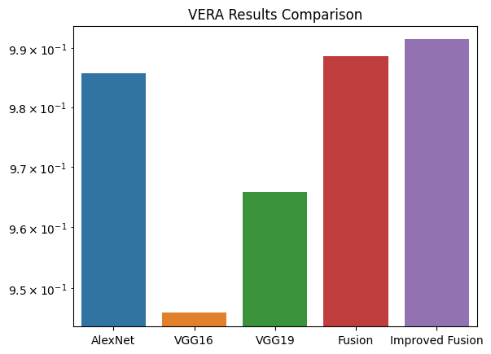
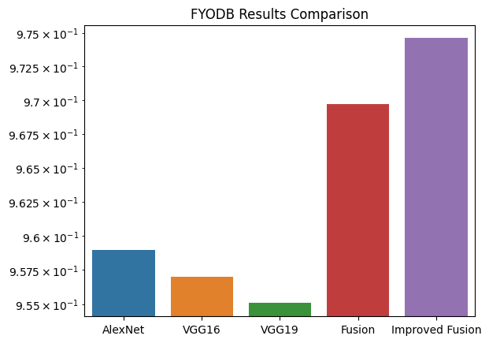
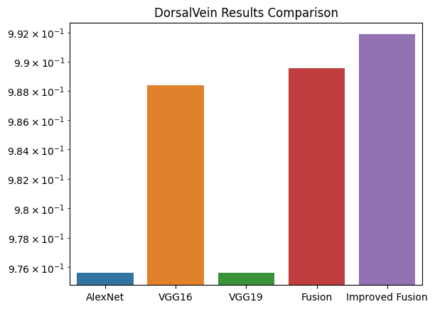
Decision-Level Fusion Results
Dataset | Fusion Accuracy | Modified Fusion Accuracy
VERA | 98.86% | 99.15%
FYODB | 96.97% | 97.46%
DorsalVein | 98.95% | 99.19%

Slide 16
Conclusion
This study successfully implemented a robust and accurate system for Palm-Vein biometrics that produces very strong results on three different datasets.
If implemented, this framework can allow for very high security in crucial infrastructure such as the banking or government sector.
The results also demonstrate the power of ensemble models and the importance of the technique used to perform the decision fusion of the individual models.

Slide 17

Thank You! We welcome your questions!

